Slide 1
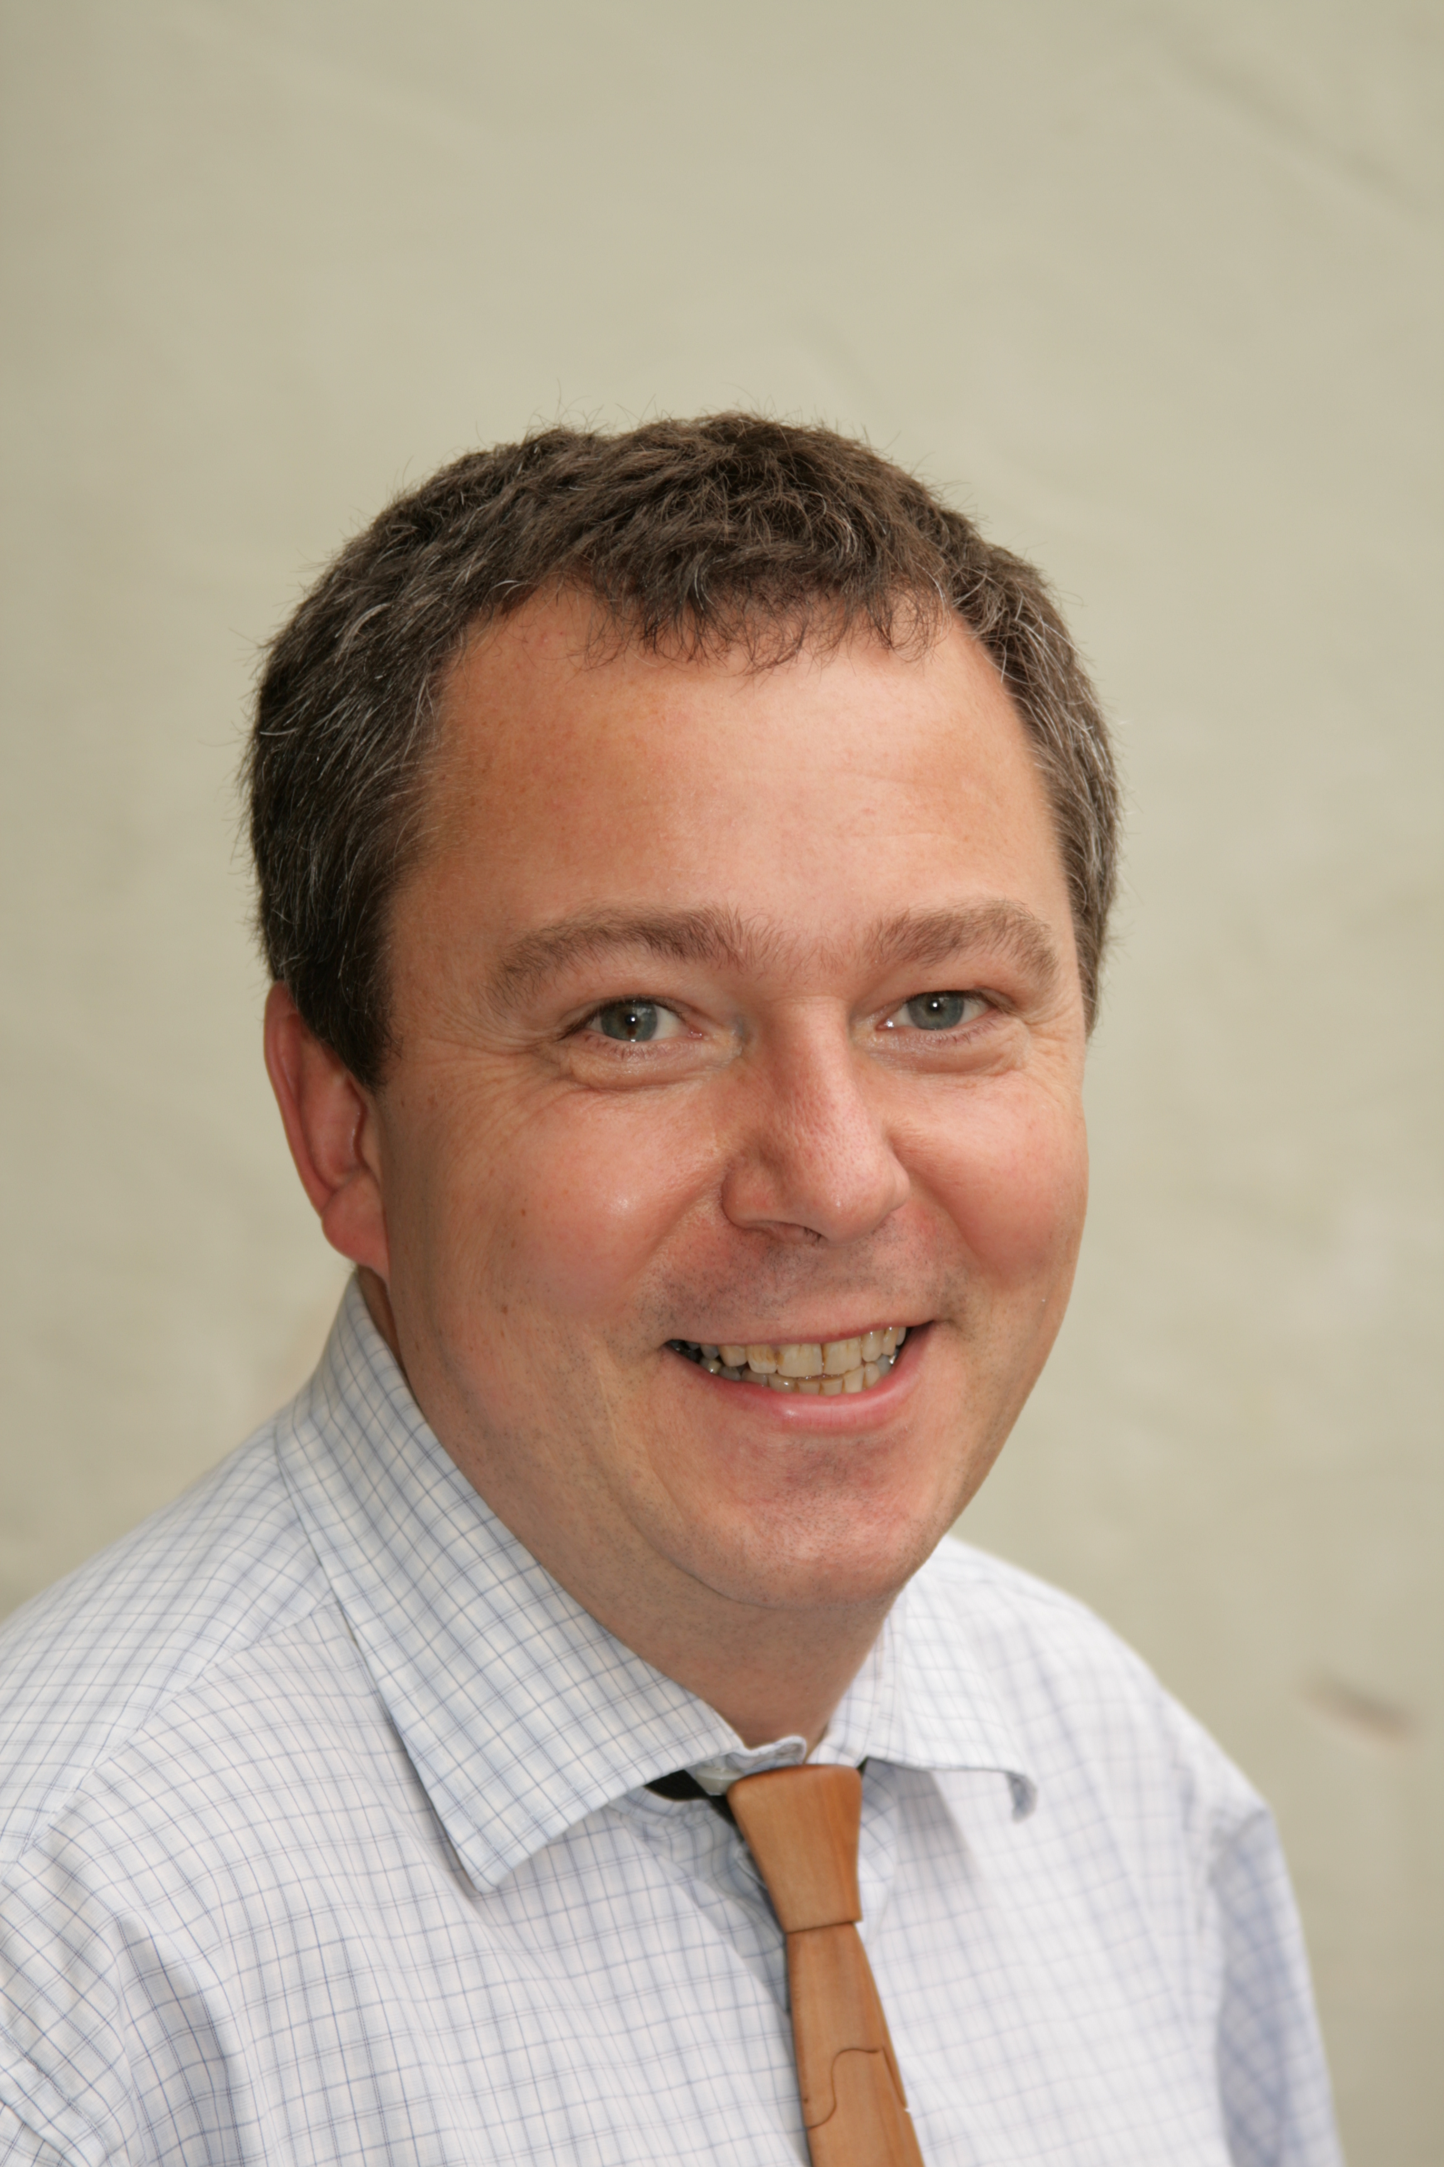
Passive House Building envelope in all climatic regions
– solutions for the practice franz freundorfer

Slide 2
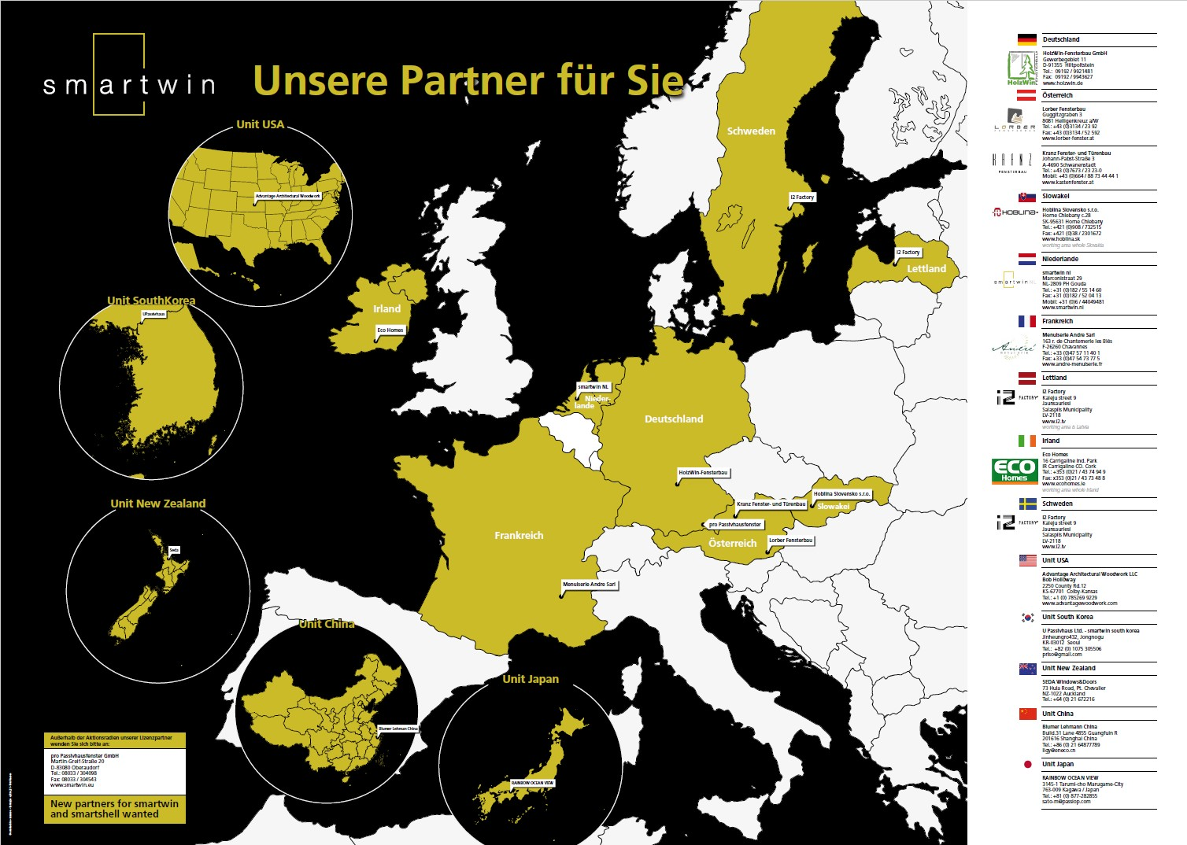
Our partners around the globe
present
partners around the globe
specific regional products needed in all different climate regions
Just market cozy homes as your product
and not its components.
Passive House is “just” the
energy standard
of your product.

Slide 3
History of smartwin and smartshell cooperation
Founding smartwin
Mathilde Andre, Sepp Lorber, Franz Freundorfer
November 2010
Development of seven PH window and door systems
July 2018 today five partners
Founding smartshell
August 2016 Kansas, South Korea, China, New Zealand, Japan
Start of new units outside of Europa
EU cooperation grows to 12 smartwin members
till end of 2016
till end of 2015 on the market
Since 2010, we invest 100% of the license fee into smartwin cooperation for further development and marketing. The result is 5% development budget from our partners’ turn over.
Notes:
The founders Mathilde Andre (France), Sepp Lorber (Austria) and Franz Freundorfer (Germany) have gained more than 20 years of experience in the PH window section. At the moment, there are eight different PH window and PH door components available. All these products are produced according to the certifications and CE signing by one single company in Styria. After the go-life of a new product is done and a couple of projects are free of any quality problems, the product gets free for the production to all license partners.

Slide 4

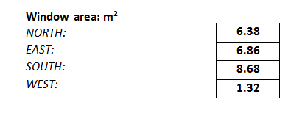
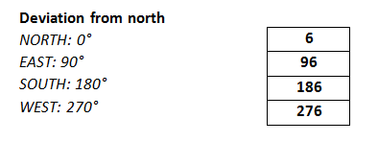
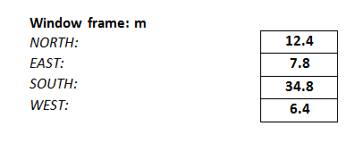
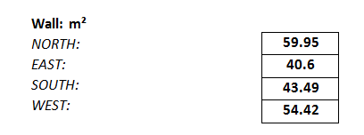


Phquick: 25 numbers from the project and half an hour work for input to phquick
ü
From these geometric data, a PHPP is automatically generated.

Slide 5
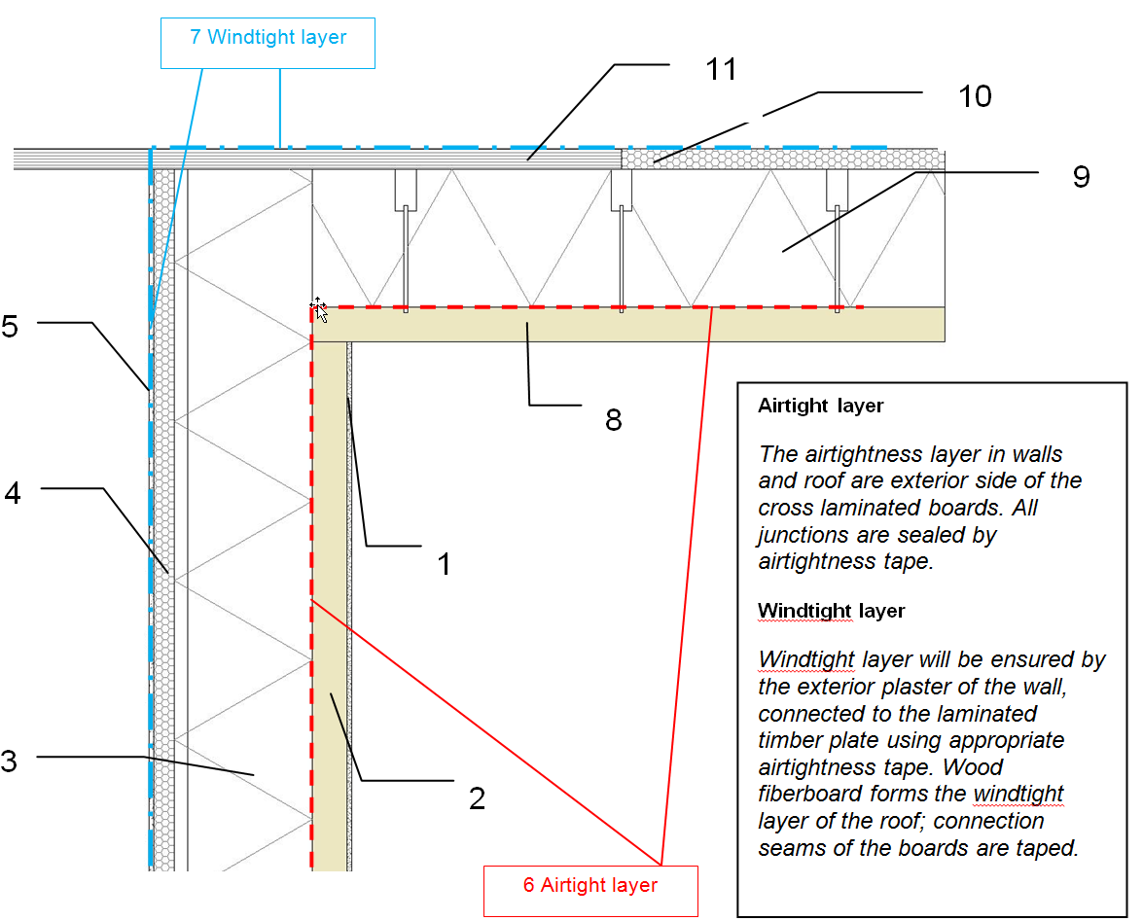
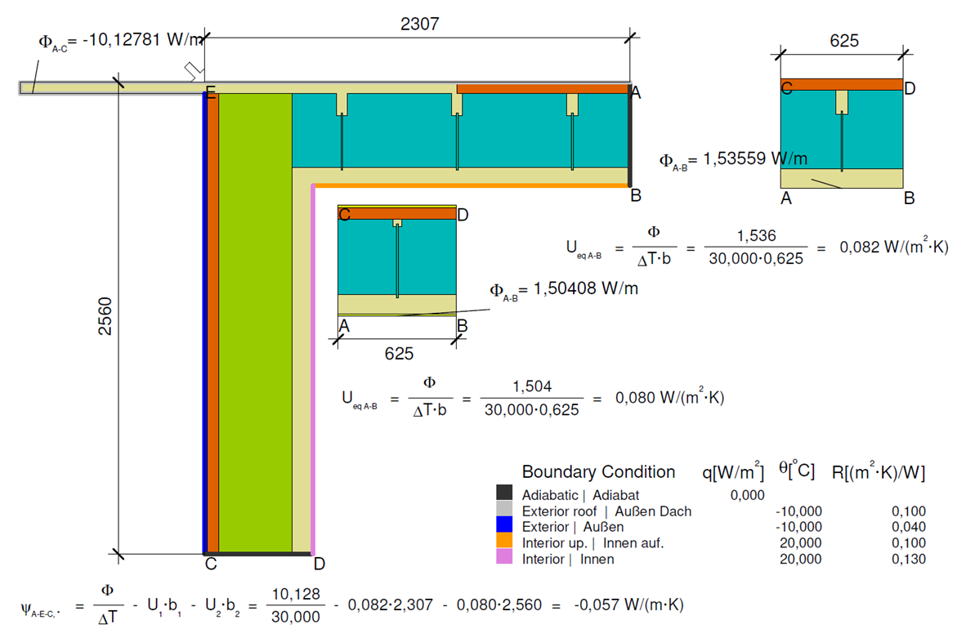
Certified wall and building system as your standard
ü
This documentation contains all necessary information. "It's the Bible of the building!"

Slide 6
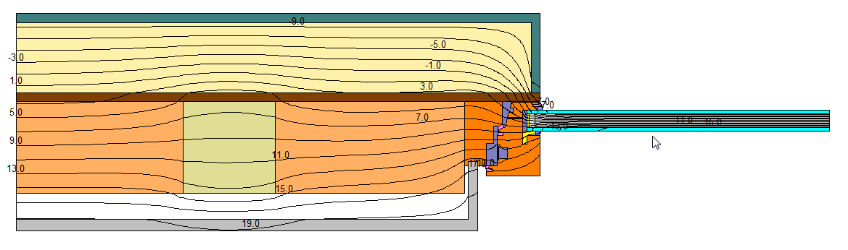
Window inclusion of smartwin compact in Japanese timber frame construction
Inclusion of window => window frame is part of the wall

Slide 7
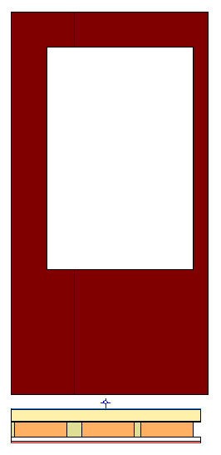
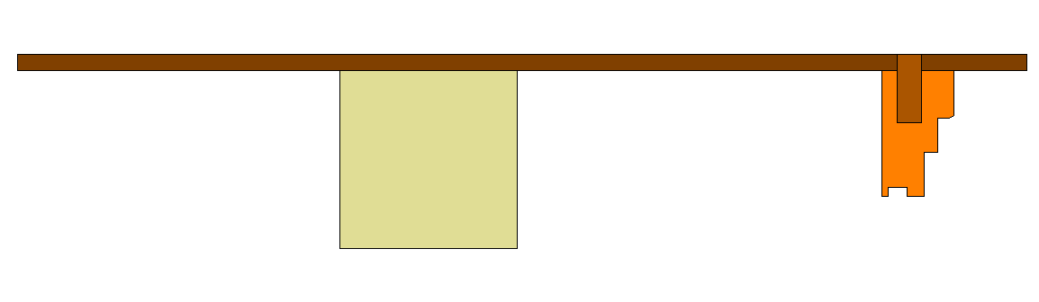
Creation of an exact window opening in the plywood with holes for the position of frame parts
ü
Plywood has exact holes from prefabrication.
The frame profiles with wooden dowels are positioned along these holes.
The final fixing is done with screws made of plywood in the frame.
Fitting of single frame elements into plywood plate

Slide 8
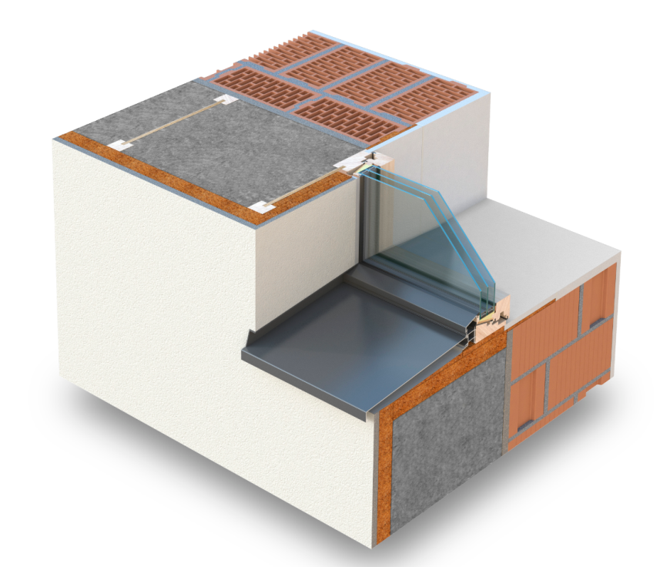
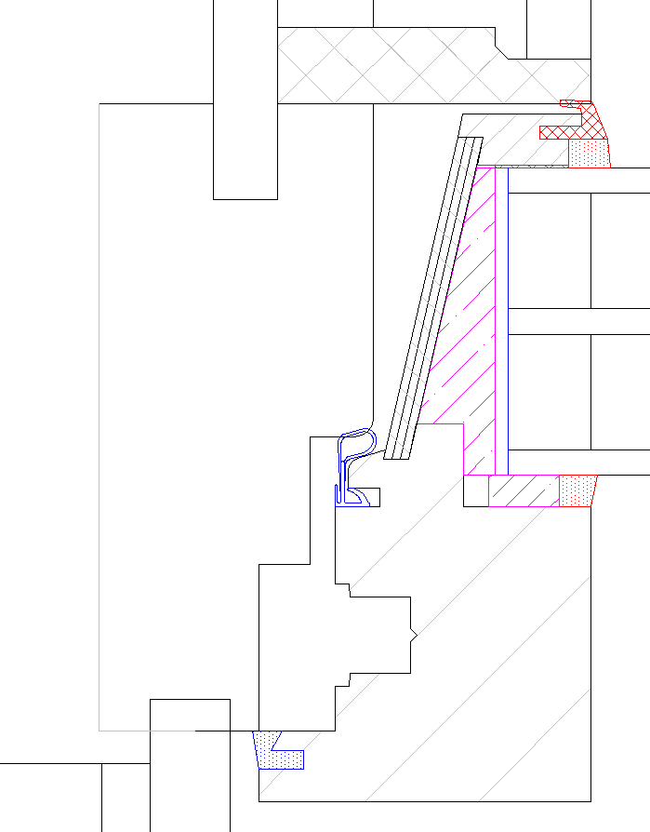
A nice, slim and inclused window in retrofit
EnerPhit needs light and bright rooms

Slide 9
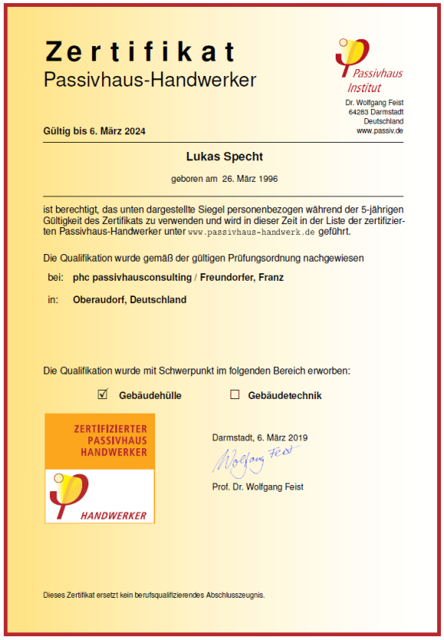
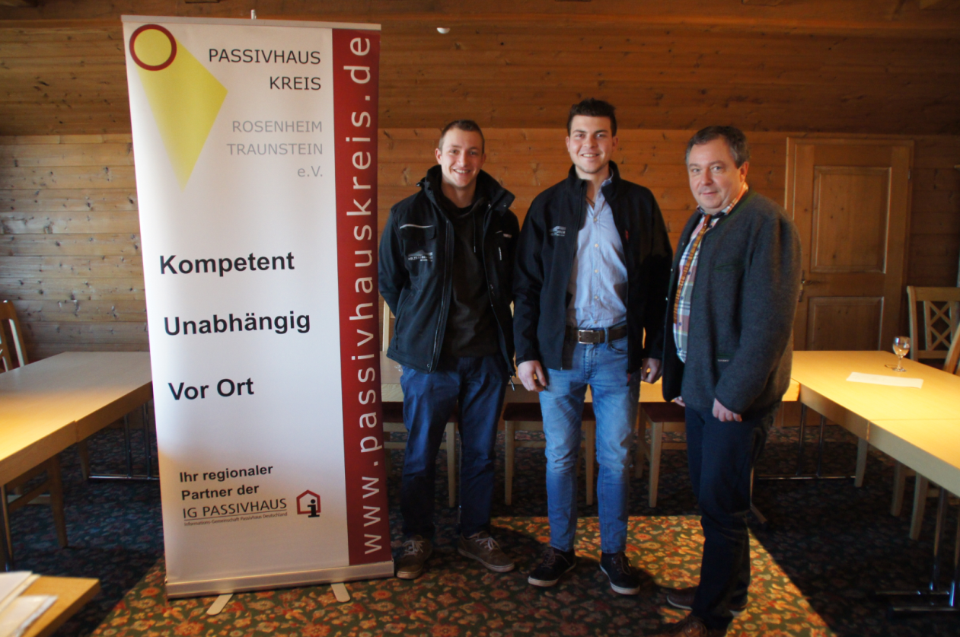
Certified Passive House designer and craftsmen in all trades
ü
The good ones do not fall off the trees. Educate them!

Slide 10
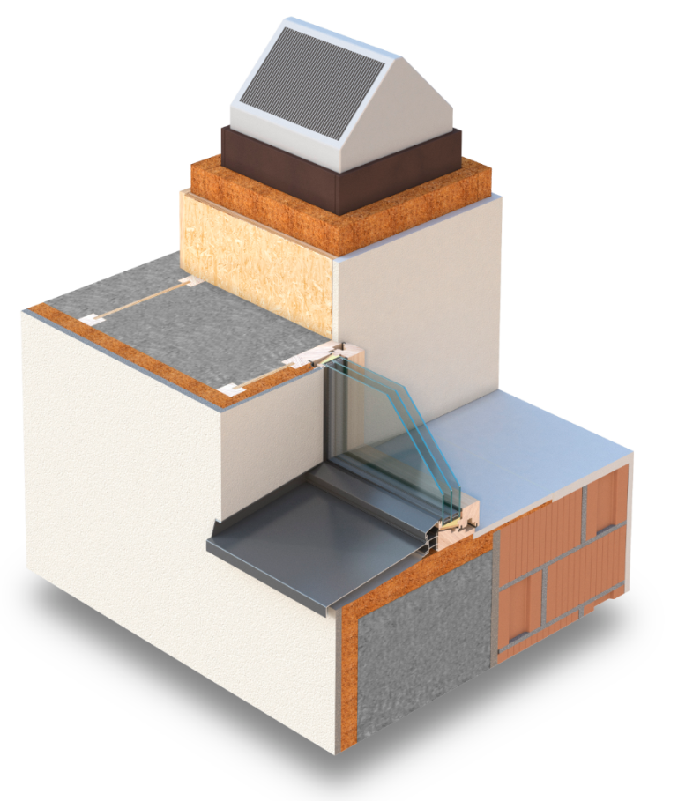
Ventilation through integration into building envelope
A passive house certified, CE signed comfort ventilation unit with a nominal flow rate of max. 180 m³ can be produced in small amounts below 1000,- EUR.
Thus, the end consumer can still earn money with his fresh air.

